Slide 1

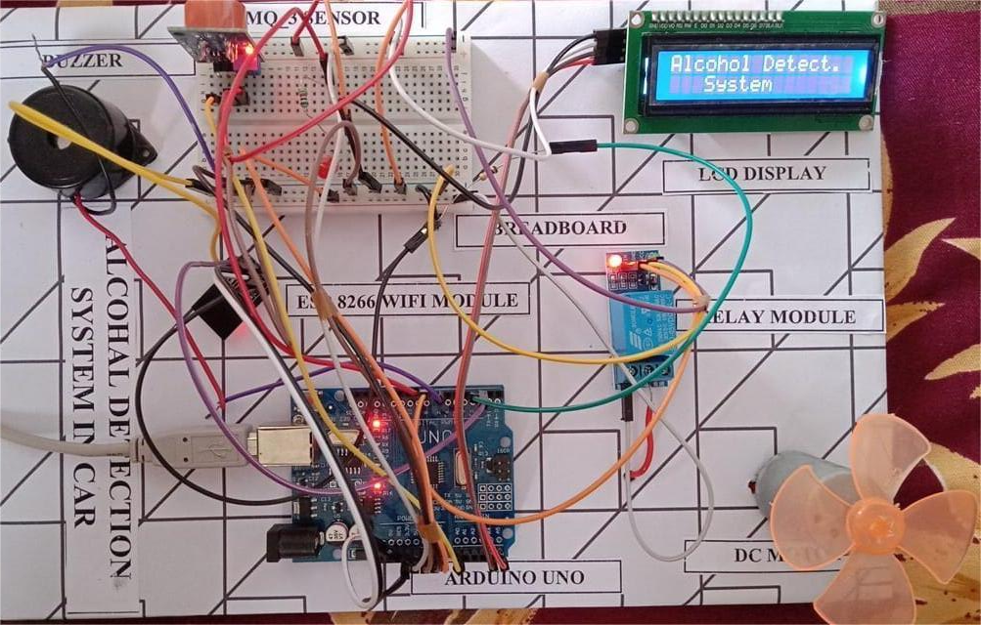
ALCOHOL DETECTION SYSTEM
Project overview by:
24R05A0538 - R.Rohith
BRANCH : CSE
UNDER THE GUIDENCE OF :
Mr.P.Vijay kumar

Slide 2
ABSTRACT
This project aims to reduce drunk driving accidents by integrating an alcohol detection system in vehicles. Using an MQ-3 sensor, the system checks the driver's breath for alcohol before and during the ride. If alcohol is detected above a set threshold, the engine remains off or the car gradually stops. Alerts are provided via an LCD, buzzer, and LED indicators. This low-cost, efficient solution enhances road safety and can be implemented in real-world vehicles.

Slide 3

INTRODUCTION
Road safety has become a major concern worldwide, with drunk driving remaining one of the leading causes of traffic accidents and fatalities. To address this issue, technological advancements have led to the development of alcohol detection systems in vehicles. These systems aim to prevent intoxicated individuals from operating a vehicle, thereby reducing the risk of accidents and saving lives. Alcohol detection in cars typically involves sensors that can measure a driver’s blood alcohol concentration (BAC) through breath, skin contact, or cabin air analysis. Some systems can even disable the ignition or alert emergency contacts if alcohol is detected beyond legal limits. As governments and automobile manufacturers push for safer driving conditions, integrating alcohol detection technology into vehicles is becoming a crucial step toward achieving zero-accident roads.

Slide 4

WHY ALCOHOL DETECTION IS NECESSARY
Prevents Drunk Driving: Detects intoxicated drivers before they can operate the vehicle, reducing the risk of accidents.
Enhances Road Safety: Helps lower the number of road crashes caused by impaired driving.
Saves Lives: Reduces fatalities and serious injuries resulting from alcohol-related accidents.
Promotes Responsible Behavior: Discourages individuals from drinking before driving, encouraging safer habits.
Supports Law Enforcement: Assists in enforcing DUI laws and minimizing violations.
Protects Other Road Users: Ensures the safety of pedestrians, passengers, and other drivers.

Slide 5

WHY IS ALCOHOL DETECTION NECESSARY
There are several methods to detect alcohol in a driver before or during driving.
Breath-based sensors measure alcohol from exhaled air using breathalyzers.
Touch-based sensors detect alcohol through skin contact, often on the steering wheel or start button.
Air cabin sensors analyze the air inside the vehicle for alcohol presence.
Eye or behavior monitoring systems track driver alertness and signs of impairment

Slide 6

Technologies involved
MQ-3 Alcohol Sensor: Detects ethanol from the driver’s breath and outputs analog signals.
Arduino Uno: Processes sensor data and controls system components in real-time.
Embedded System Design: Integrates sensing, processing, and control for autonomous safety enforcement.
Web Interface with Chart.js: Displays alcohol data graphs and trends using browser-based dashboard.
Future Expandability: Can be upgraded with AI for behavior analysis and GSM for real-time alerts.

Slide 7



Case studies
Problem: Drunk driving causes numerous road accidents and fatalities.
Objective: Prevent vehicle ignition if the driver is intoxicated.
Solution:
MQ-3 sensor detects alcohol from breath.
Arduino processes data and controls relay, buzzer, LED, and LCD.
Web dashboard shows alcohol levels using Chart.js.
Outcome:
Vehicle doesn't start if alcohol is detected.
Alerts driver via buzzer, LED, and display.
Alcohol data visualized in real-time.
Future Scope:
Add GSM for emergency alerts.
Integrate AI for driver behavior analysis
Suitable for school buses, taxis, and fleets.

Slide 8






Challenges/limitations
Limited Processing Power Not suitable for complex tasks like machine learning, video processing, or heavy computations.
Small Memory Size RAM and storage are minimal, restricting the handling of large codebases or datasets.
No Built-in Internet Connectivity Most boards lack Wi-Fi or Bluetooth unless external modules are added.
No Multitasking Support Cannot run multiple tasks simultaneously; relies on timers or interrupts for task management.
Basic Security Features Does not offer native encryption or authentication, which limits IoT security.

Slide 9

Future of alcohol detection
in vechiles
Seamless Sensor Integration: Alcohol sensors will be built directly into standard vehicle systems.
AI & Machine Learning: Used to detect impairment through behavior and physical signs for higher accuracy.
Non-Invasive Methods: Touch and air-based sensors will become more advanced and common.
Standard Safety Feature: Automakers may include detection systems to meet safety laws and reduce accidents.
Smart Connectivity: Vehicles may send real-time alerts to law enforcement or nearby drivers.
Role in Autonomous Cars: Detection systems will ensure only sober passengers use self-driving vehicles.

Slide 10
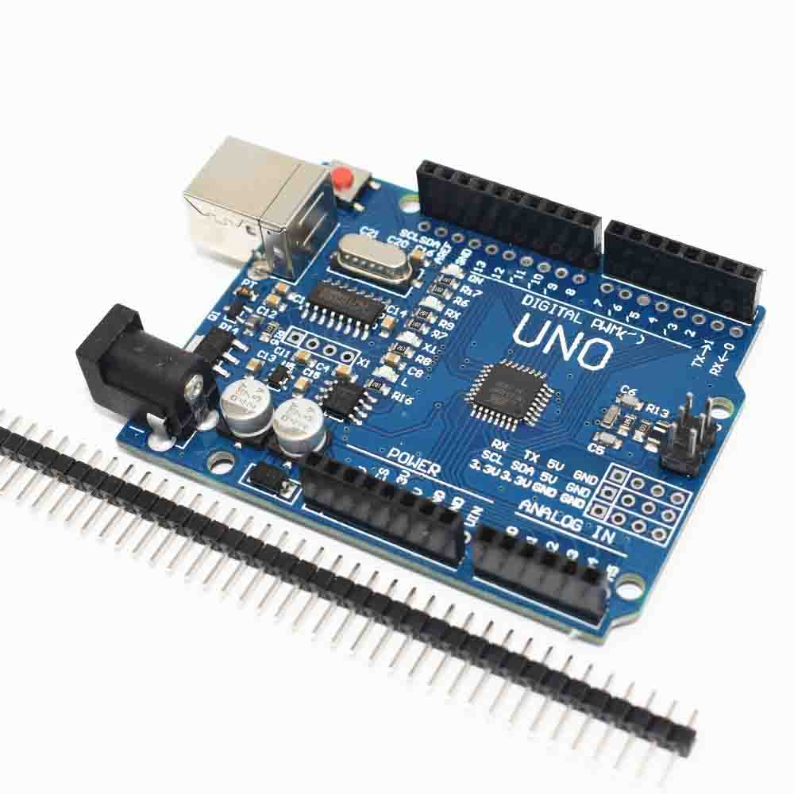
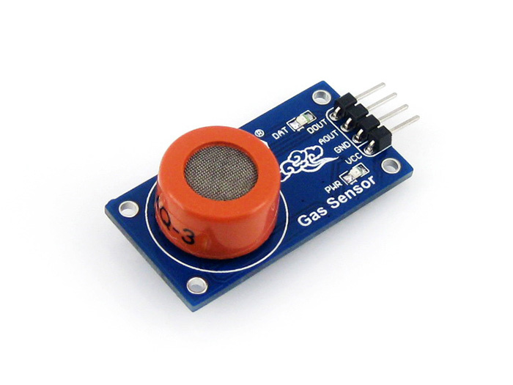
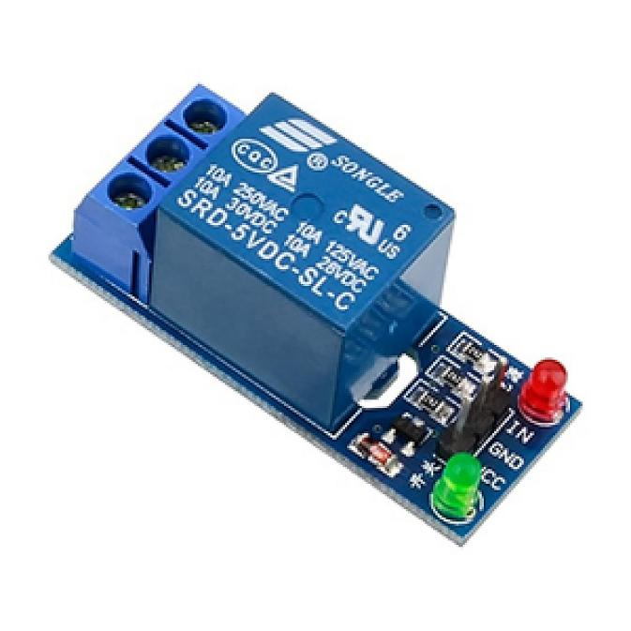
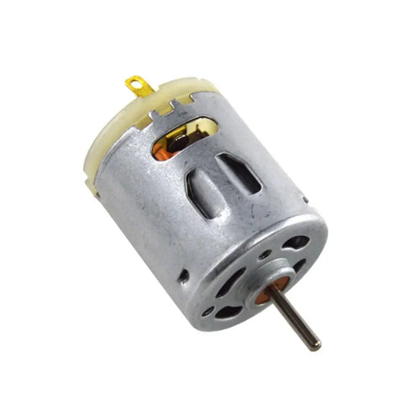
COMPONENTS
Arduino Uno:
Microcontroller board that processes sensor data and controls connected devices.
Acts as the brain of the system.
Relay Module (5V):
Works as a switch to control high-power devices like motors.
Used to enable or disable the vehicle’s ignition.
MQ-3 Alcohol Sensor:
Detects alcohol concentration from breath.
Sends analog signal based on ethanol level.
DC Motor:
Simulates vehicle engine in the prototype.
Controlled via relay based on alcohol detection.

Slide 11
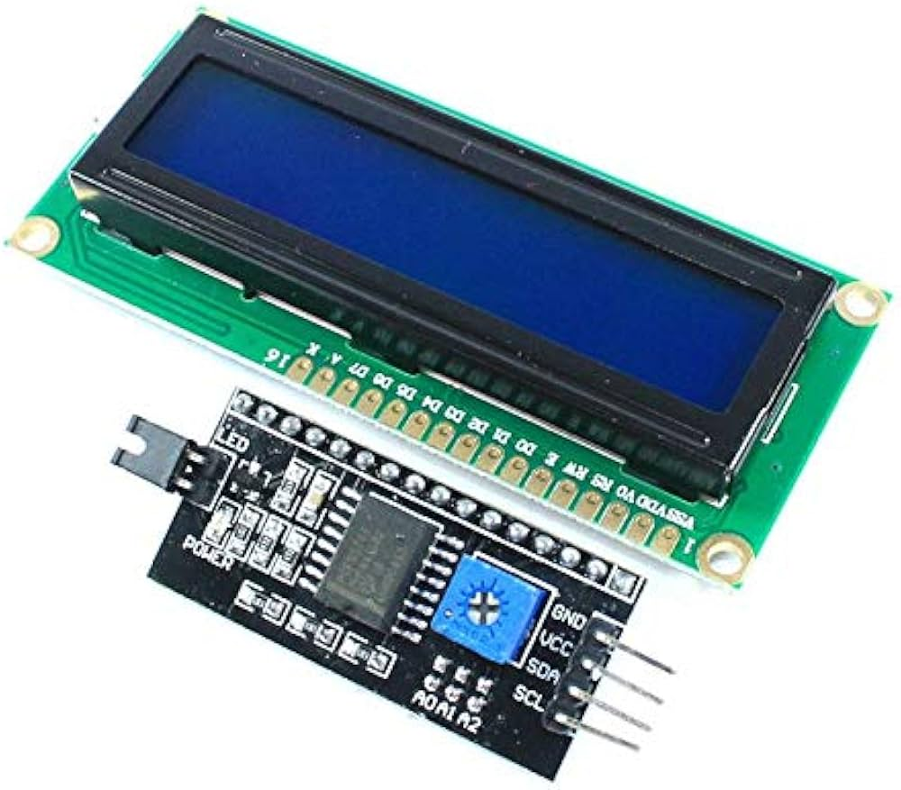
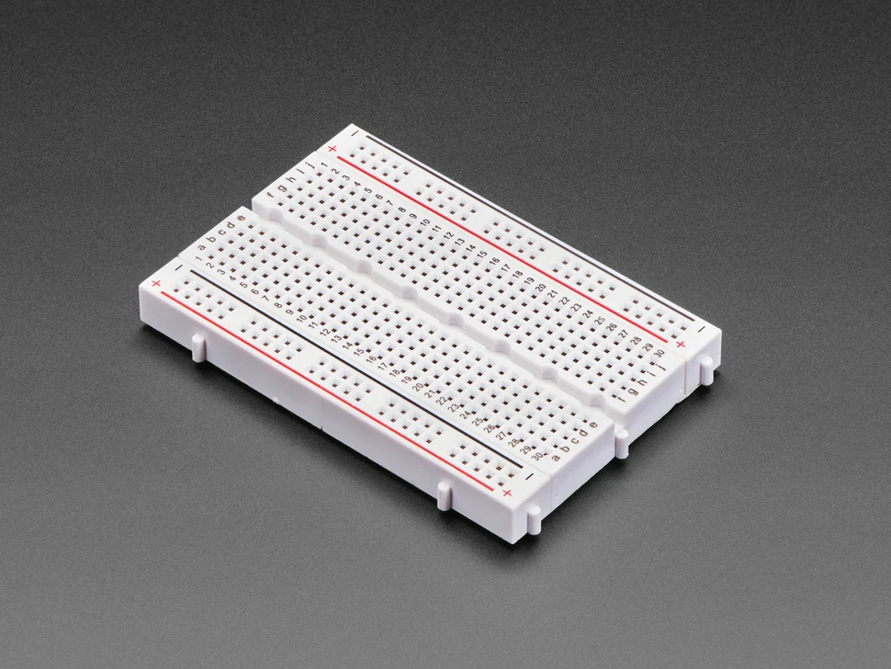
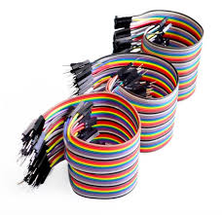
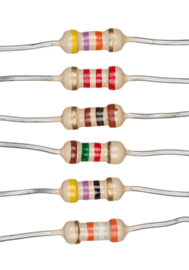
COMPONENTS
LCD Display (16x2 with I2C):
Displays messages, alerts, and status to the driver.
Uses I2C for easier wiring with only 4 connections.
Breadboard:
Allows easy and temporary circuit assembly without soldering.
Useful for prototyping and testing connections.
Jumper Wires:
Used to connect components on the breadboard and to the Arduino.
Available in male-to-male, female-to-female, and male-to-female types.
Resistors:
Limit current to protect sensitive components.
Commonly used with LEDs and sensors.

Slide 12
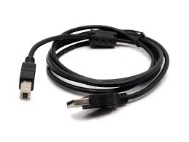
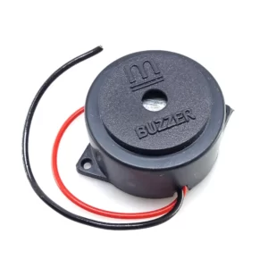
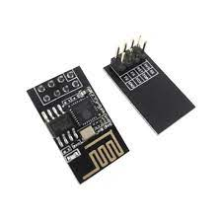
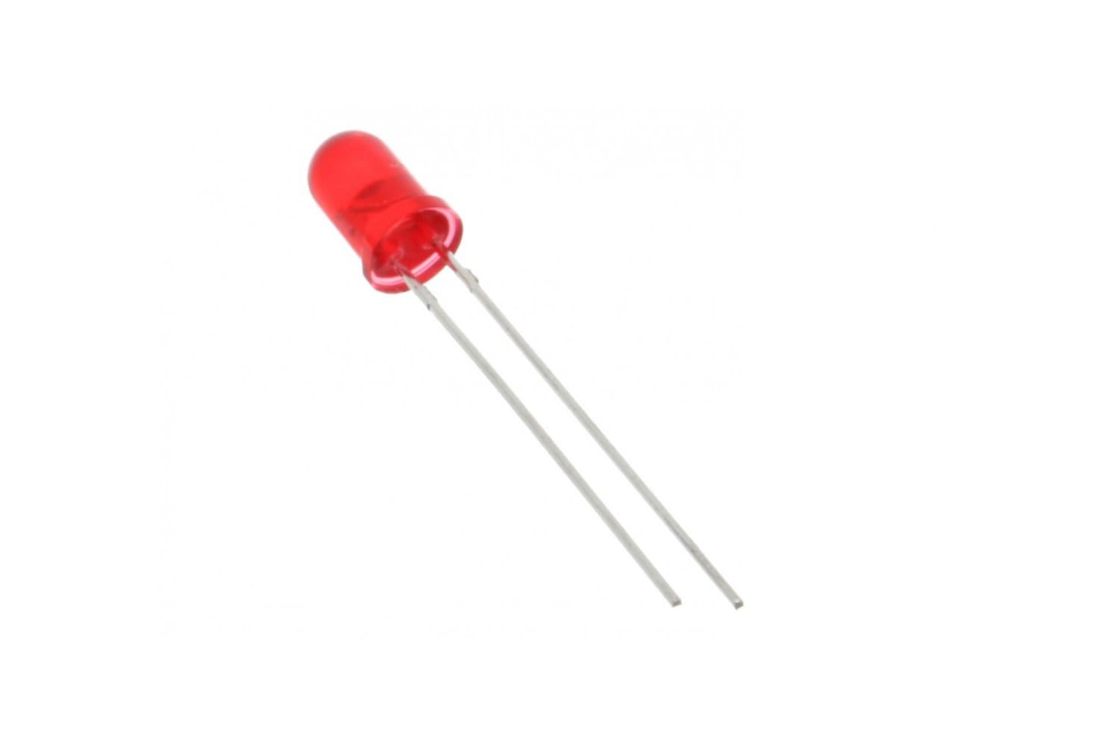
COMPONENTS
Arduino Cable:
Used to upload code and power the Arduino Uno.
Enables communication between Arduino and PC.
Buzzer:
Emits sound when alcohol is detected.
Alerts the driver instantly with audio signals.
ESP8266 Wi-Fi Module:
Adds internet connectivity to the system.
Sends data to a web server for monitoring.
LED:
Lights up to indicate alcohol detection.
Provides a quick visual alert.

Slide 13
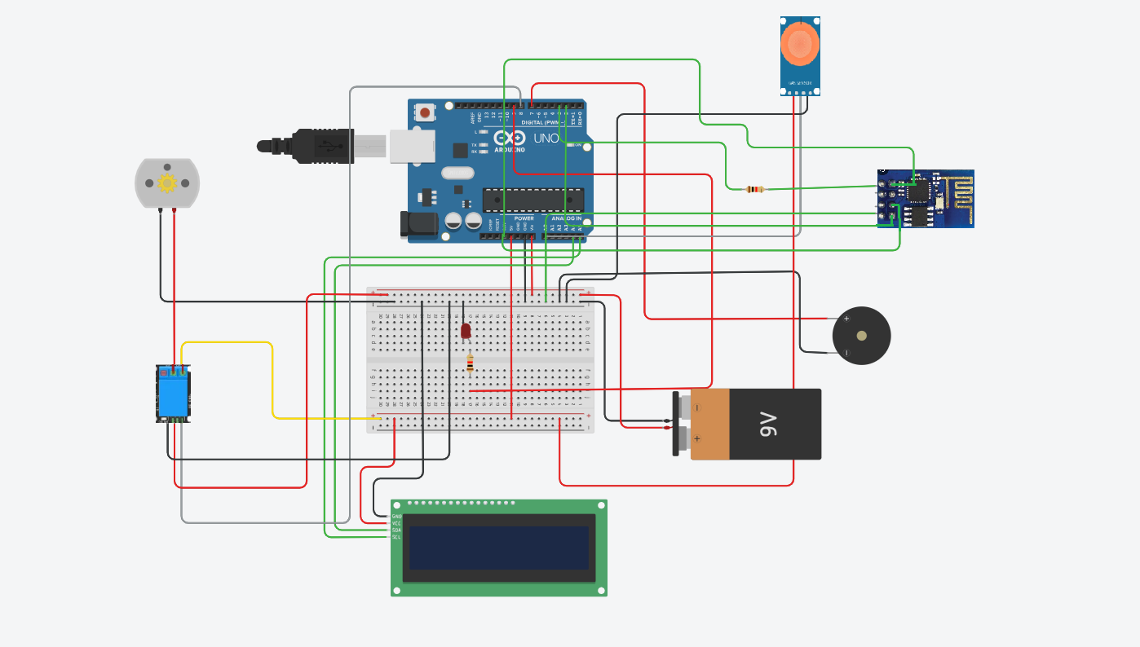
Circuit diagram

Slide 14

conclusion
Alcohol detection in vehicles is essential for improving road safety and preventing drunk driving. Technological advancements are making these systems more accurate and accessible. Despite challenges like cost and privacy concerns, the benefits are significant. These systems are expected to become standard features in future vehicles. Ultimately, alcohol detection will help save lives and create safer roads for everyone.

Slide 15
THANK YOU

